Slide 1
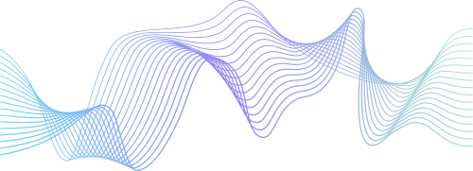
TURBULENCE
SUMMON THE CHAOS WITHIN

Slide 2
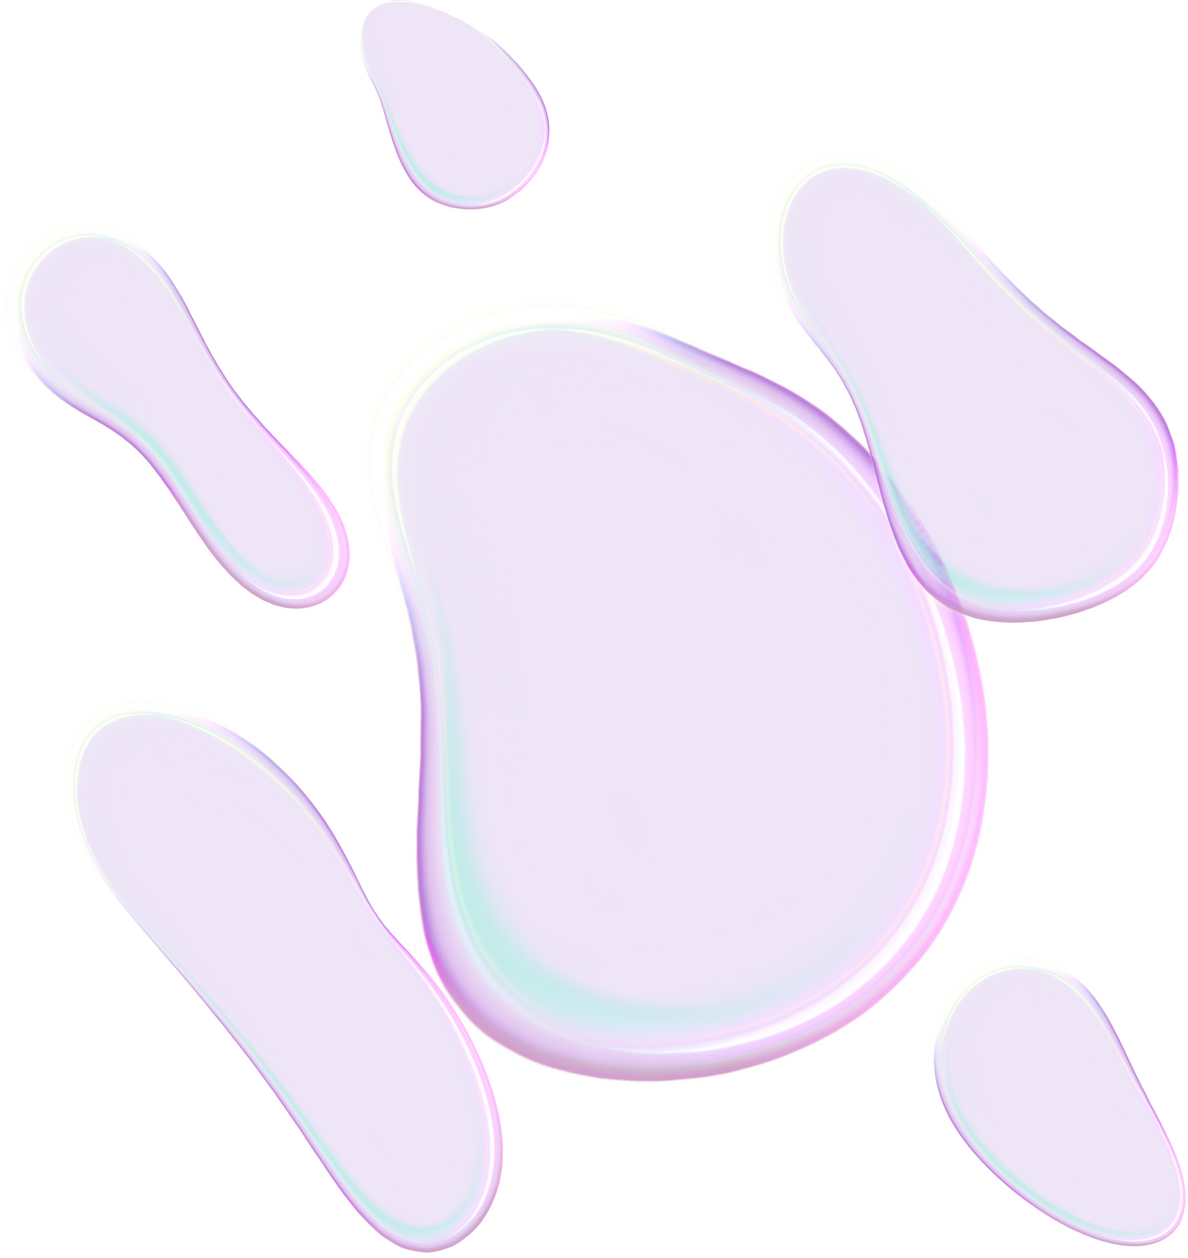




MEET THE TEAM
Soham
Taniya
Saumya

Slide 3
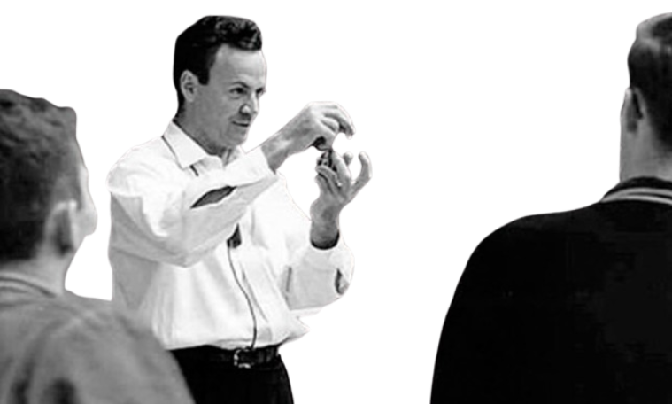
“This is the most important unsolved problem of classical physics”
RICHARD FEYNMAN

Slide 4
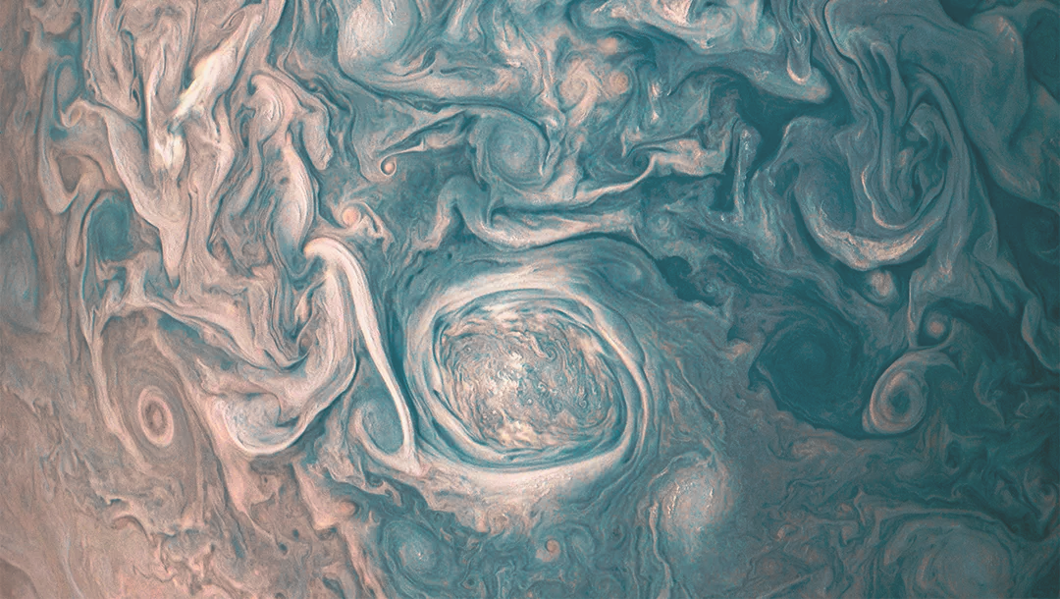
WHAT IS
TURBULENCE

Slide 5
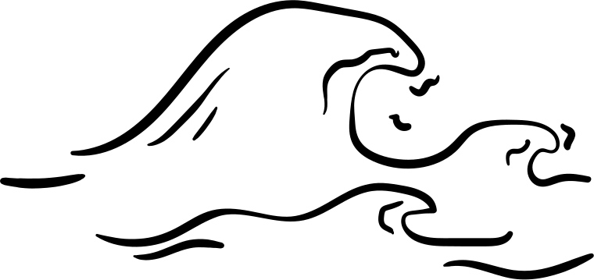
Chaotic and irregular changes in fluid pressure and velocity
Involves rapid mixing and swirling motions
Caused by excessive kinetic energy in parts of a fluid flow, which overcomes the damping effect of the fluid's viscosity

Slide 6

Sounds fascinating, isn’t it? But it can be dangerous as well, for instance on an aeroplane

Slide 7
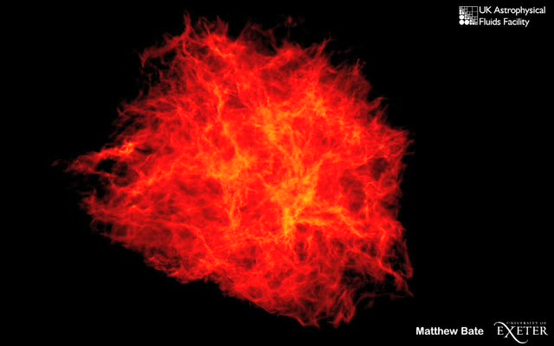
Molecular Clouds: Star Cluster Formation
Primary sites of star formation
Supported against gravitational collapse by supersonic turbulence
On smaller scales, turbulent motions compress the gas to sufficiently high densities, resulting in the formation of stars.

Slide 8
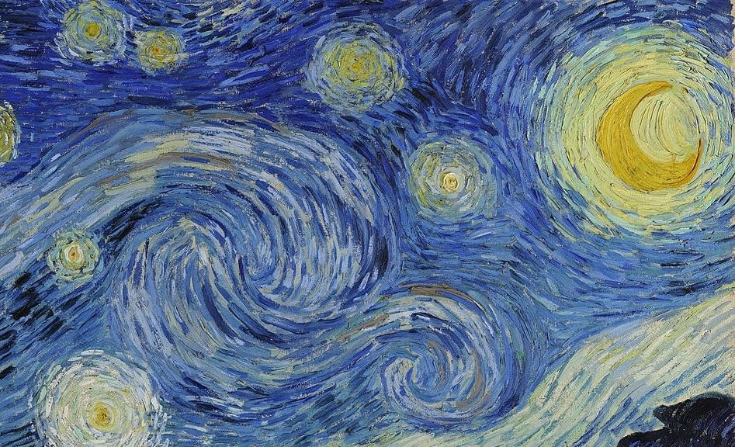
ORIGINS OF
TURBULENCE

Slide 9
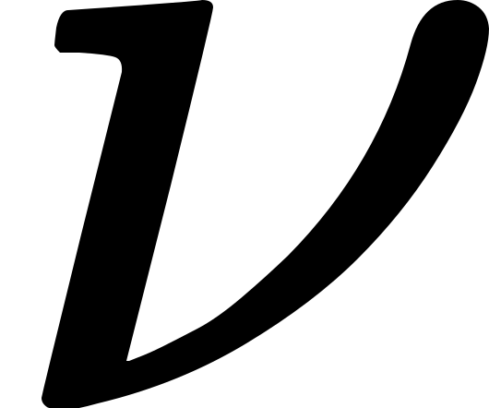
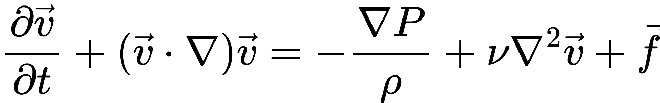
THE NAVIER - STOKES EQUATION
NSE is a partial differential equation describing motion of fluid in space
Let v(x,t) be a 3 - dimensional vector field => the velocity of fluid
f be the external volumetric force, be the kinematic viscosity
Let p(x,t) be the pressure of fluid
Then NSE -

Slide 10
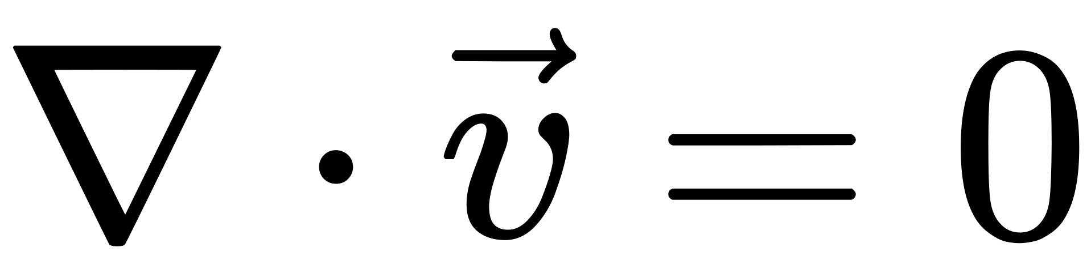
Also considering incompressible fluids, by conservation of mass
Aha, as it’s quite evident these equations are
NON LINEAR

Slide 11

Despite their fundamental nature, even the most seemingly intuitive properties of the Navier–Stokes equations remain unproven.
For the three-dimensional case, mathematicians have yet to demonstrate whether smooth solutions always exist for given initial conditions, or to discover any counterexamples.
This unresolved challenge is known as the Navier–Stokes existence and smoothness problem.
THIS IS A MILLENNIUM PRIZE PROBLEM !!

Slide 12
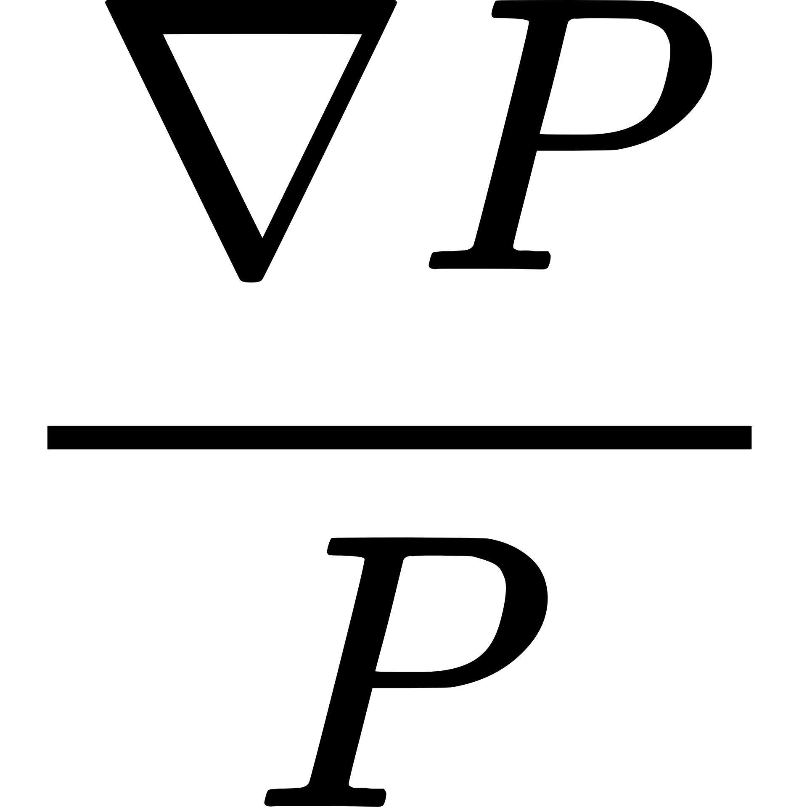
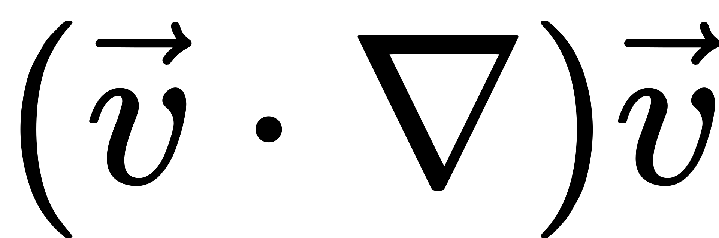
SOURCES OF NON - LINEARITY
Acceleration of the fluid
Pressure in the fluid
Implies acceleration of fluid depends on magnitude as well as direction of velocity, as well as the spatial distribution of velocity within fluids.
The pressure in a fluid depends on the density and the gradient of the pressure, and this term is therefore nonlinear in the pressure.

Slide 13


Slide 14
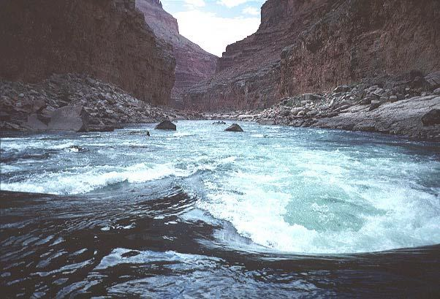
THE REYNOLDS NUMBER

Slide 15
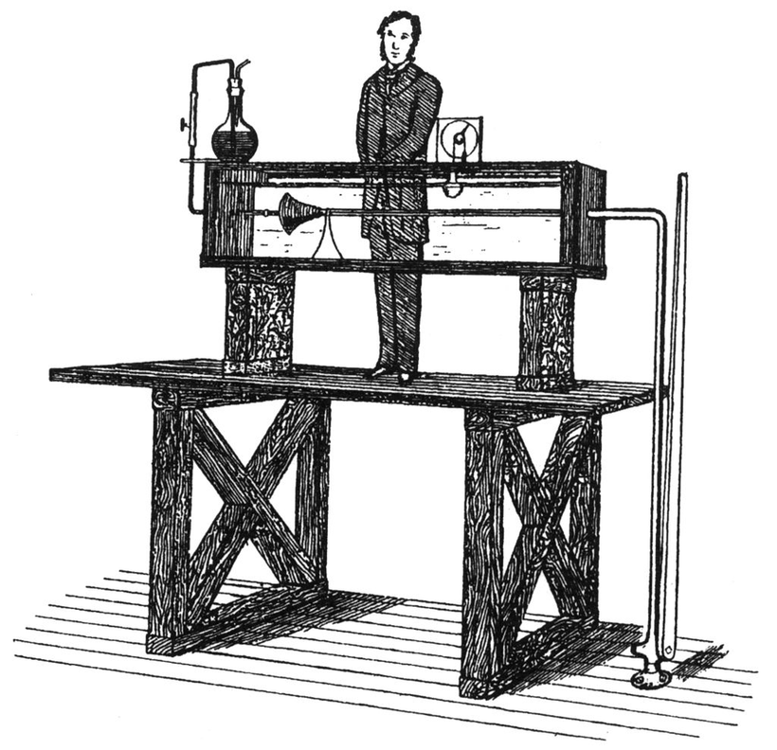
Dimensionless quantity used to predict fluid flow behavior by comparing the ratio of inertial forces to viscous forces
Low Reynolds numbers indicate laminar flow, where viscous forces dominate
High Reynolds numbers suggest turbulent flow, driven by stronger inertial forces

Slide 16
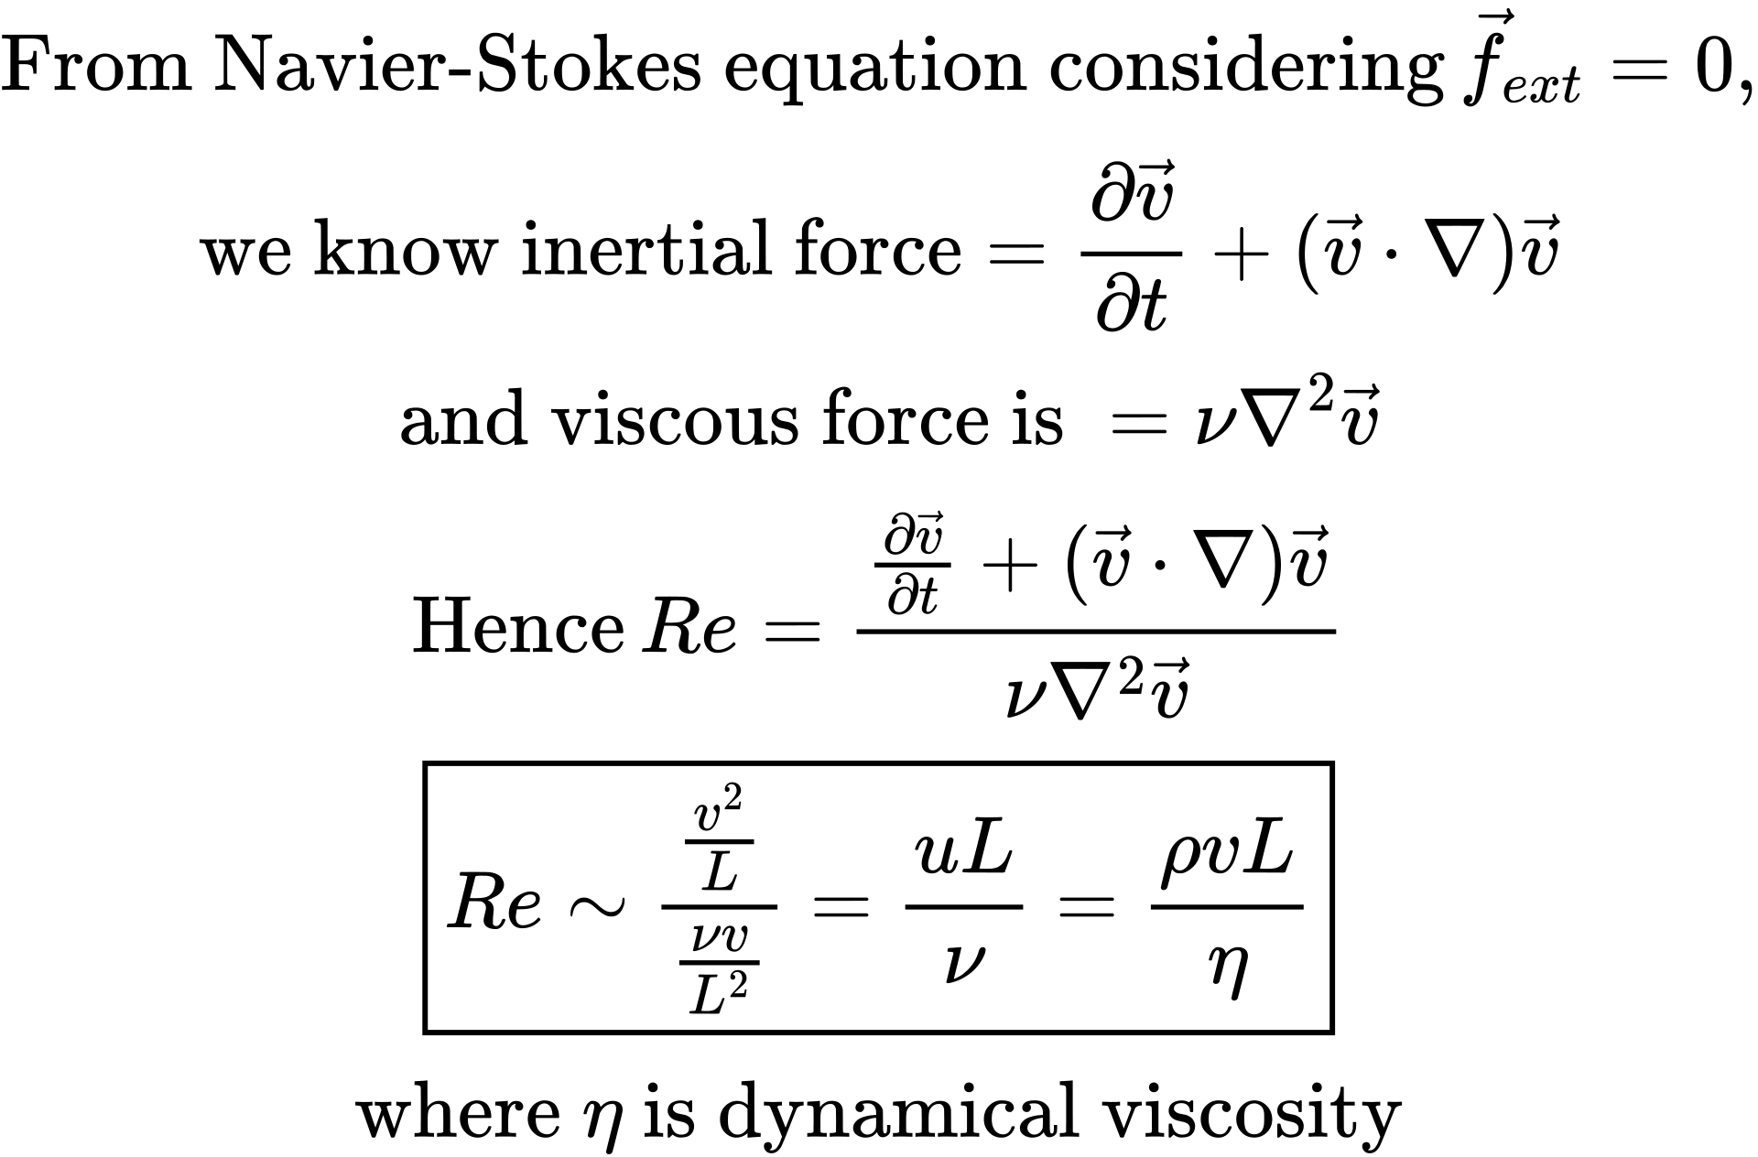
Now let’s derive it!

Slide 17
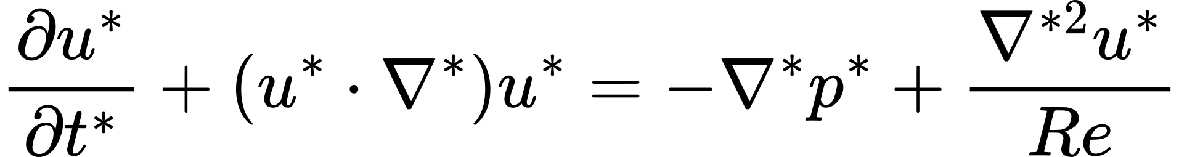
Different Re, Different Path
We conducted an experiment and simulated fluid trajectories under varying Reynolds numbers using a modified form (variable transform) of the Navier-Stokes equation as follows (non - dimensionalised):

Slide 18
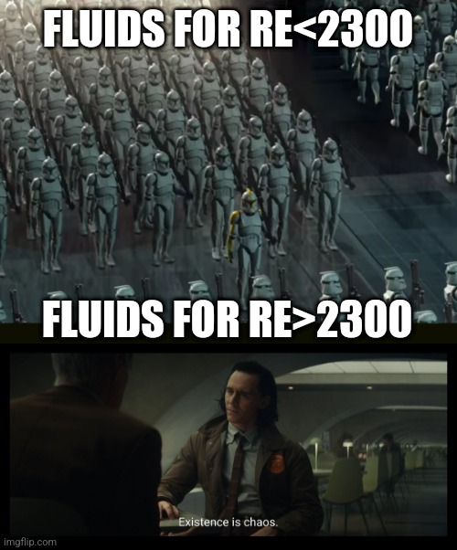

Slide 19
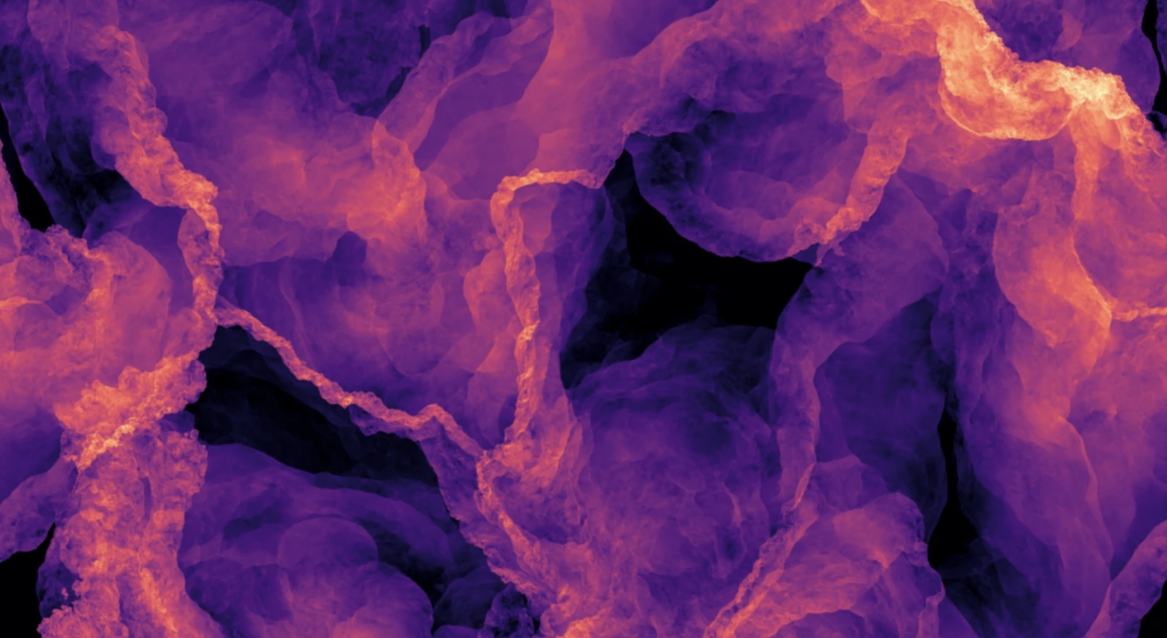
Simulation Time

Slide 20
Lattice - Boltzmann Model
The Lattice Boltzmann Model (LBM) is a CFD method used to simulate fluid flow
Unlike traditional CFD methods that solve the Navier-Stokes equations directly, LBM simulates the distribution of particle velocities on a discrete lattice

Slide 21
It is based on Boltzmann equation, which describes the statistical behavior of a thermodynamic system not in equilibrium
The method involves two main processes: streaming, where particles move to adjacent lattice nodes, and collision, where particles interact and redistribute velocities to reach equilibrium
The state of the fluid is represented by distribution functions, which give the probability of finding a particle with a certain velocity at each lattice node
Macroscopic properties like density and velocity are derived from the distribution functions using moments

Slide 22
Re << 1
Known as “creeping flow”, the dynamics are primarily governed by viscous forces
Flow exhibits a nearly symmetric behavior both upstream and downstream of any obstacles
The flow is characterized by a high degree of time reversibility, meaning that the flow patterns remain consistent when viewed in reverse.

Slide 23
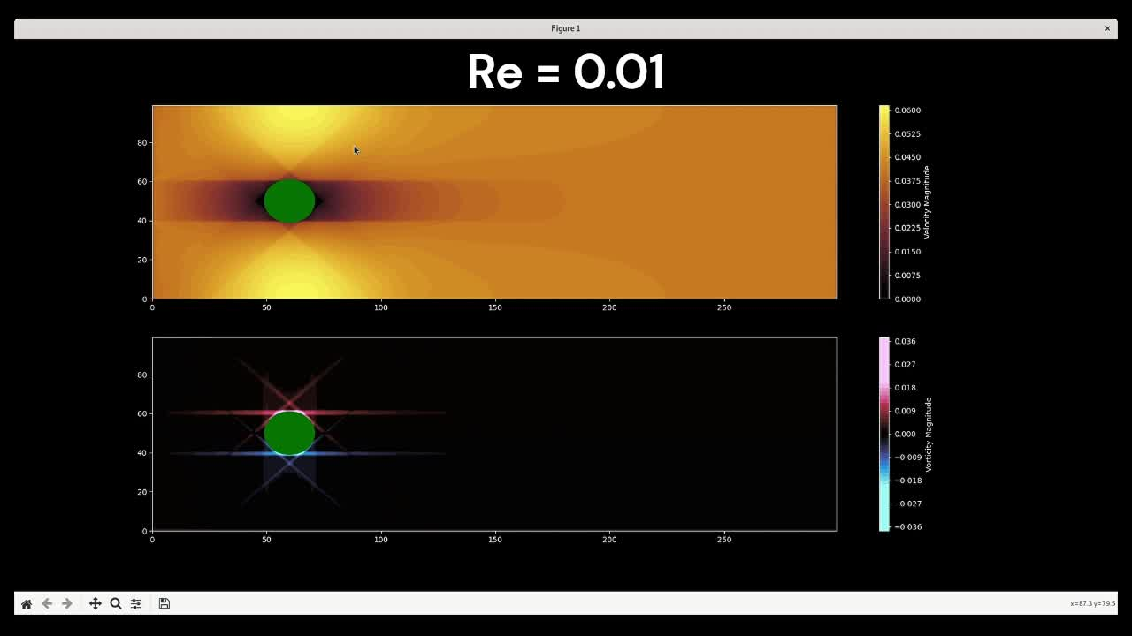

Slide 24
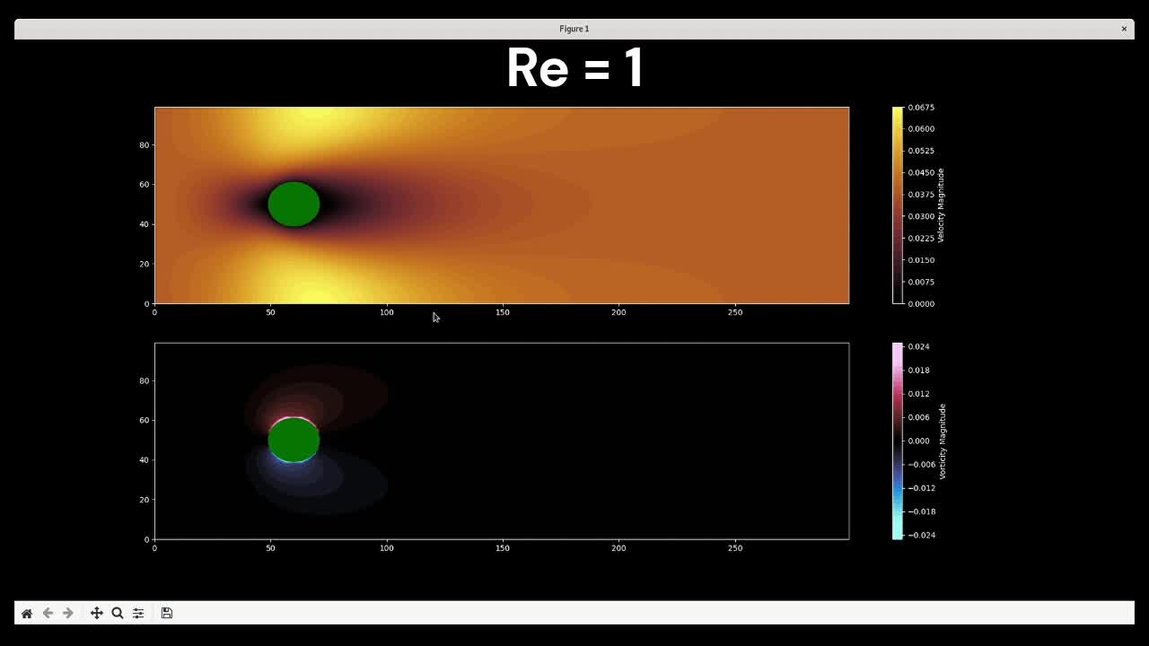

Slide 25
10 < Re < 40
Separation of the flow occurs
Leads to the formation of two counter-rotating vortices in the wake region behind the cylinder
The flow remains steady and laminar in nature.

Slide 26
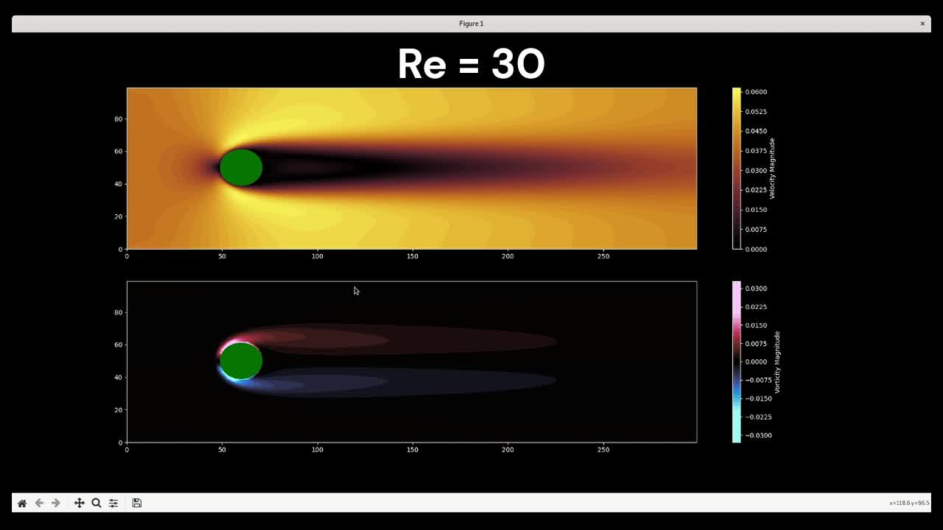

Slide 27
The von Kármán Street (40 < Re < 1000)
Unsteady laminar flow pattern characterized by the periodic shedding of counter-rotating vortices from the sides of a cylinder
When the flow speed exceeds a critical threshold, leading to the formation of alternating vortices that trail downstream
As these vortices detach from the cylinder, they create a repeating pattern
Despite the inherent unsteadiness of this flow regime, the dynamics remain relatively predictable.

Slide 28
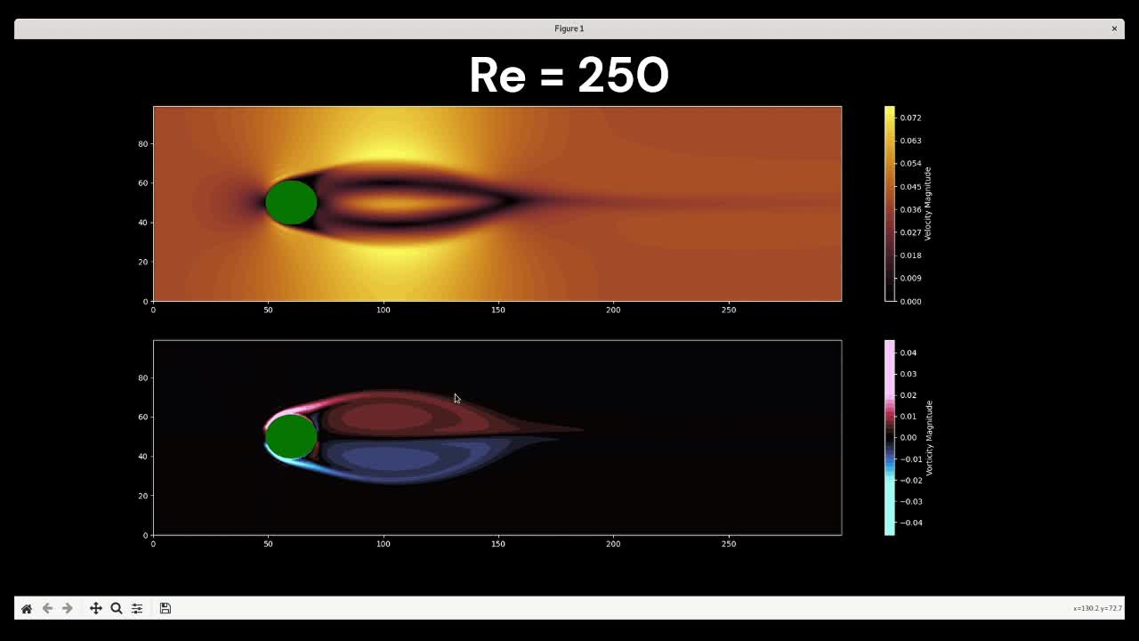

Slide 29
Re > 1000
Vortices become unstable,which results in the formation of a turbulent wake characterized by chaotic and unpredictable flow patterns
Large eddies emerge from the breakdown of coherent vortex structures, significantly influencing the transport of energy and momentum within the fluid

Slide 30
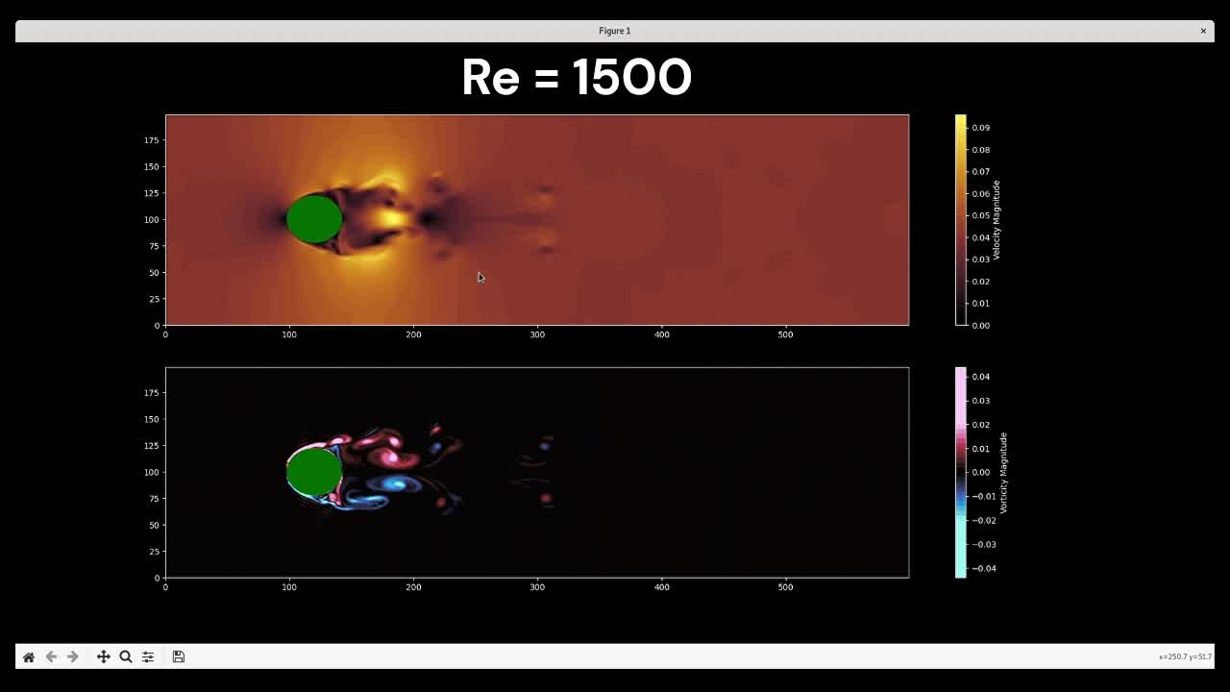

Slide 31
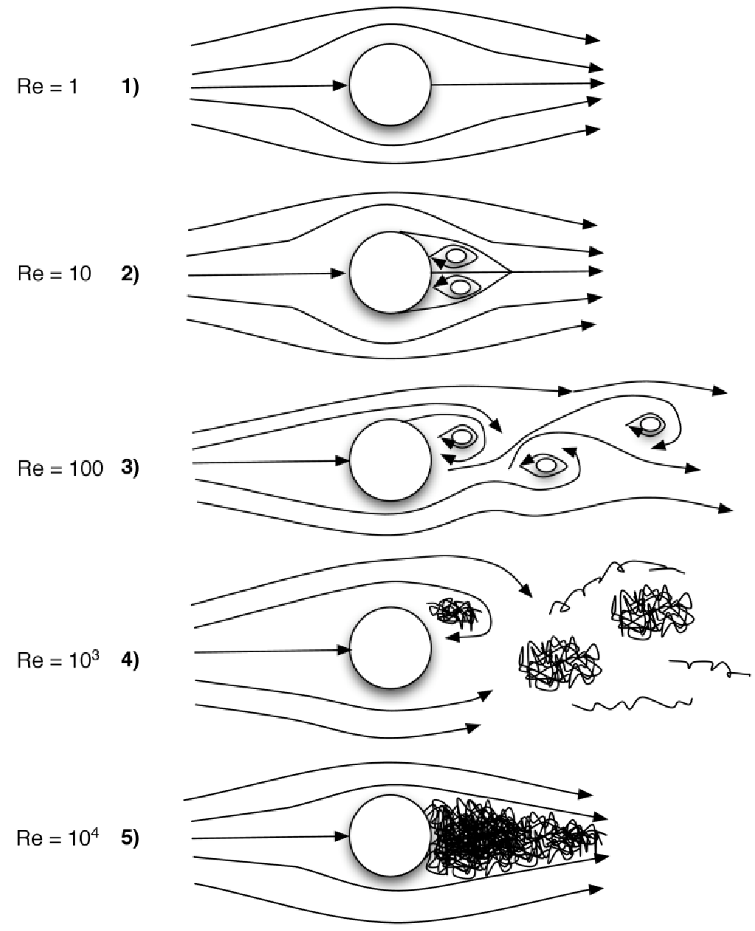

Slide 32
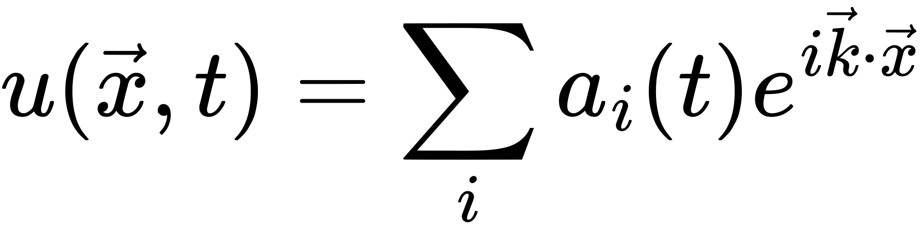
Poor Man’s Approximation to Navier - Stokes
Starting with modified NS equation, we express the solutions in terms of fourier representation of u, as
This resulting infinite system of ordinary differential equations (ODEs) for the Fourier coefficients is known as a Galerkin projection of the Navier-Stokes equations

Slide 33
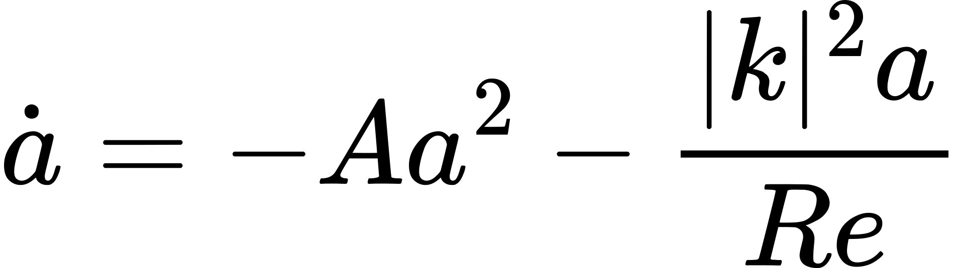
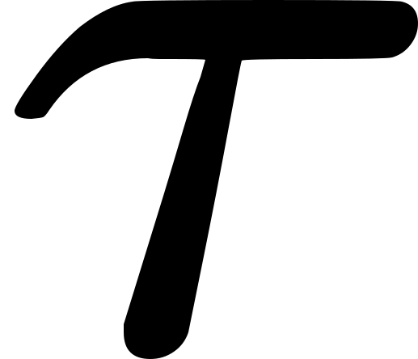
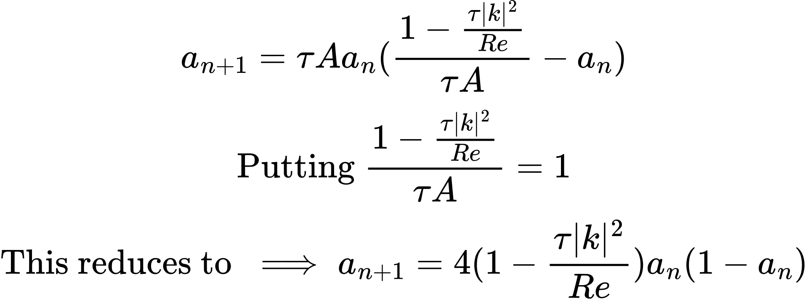
Following the procedure called Galerkin truncation, we get a reduced navier- stokes of the form
Discretizing to solve numerically, with time step of

Slide 34
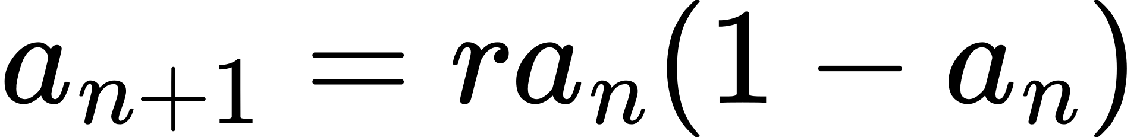
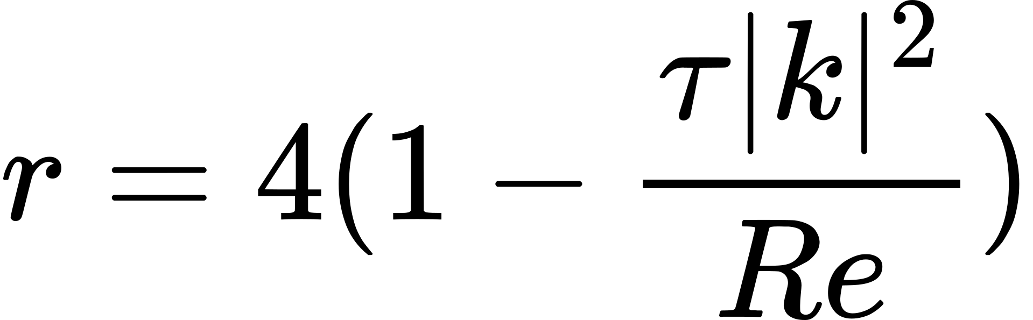
and guess what, ta-da it is the Logistic Map Equation
where
Hence the bifurcation diagram for turbulence can be obtained as

Slide 35
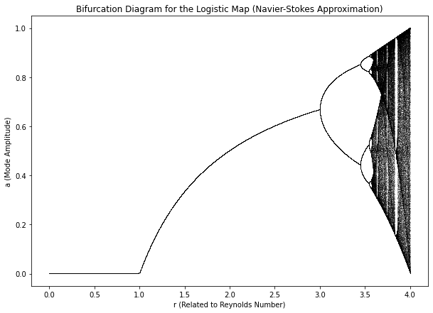

Slide 36
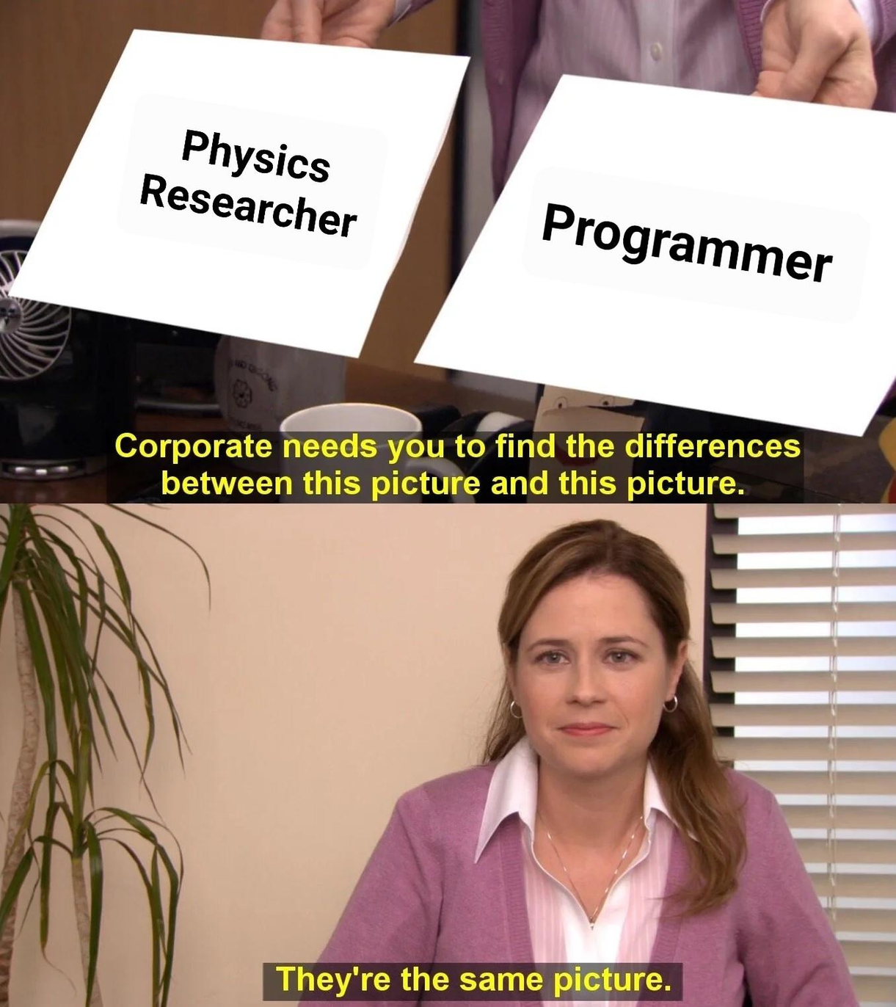
*Royal Swedish Academy of Sciences

Slide 37
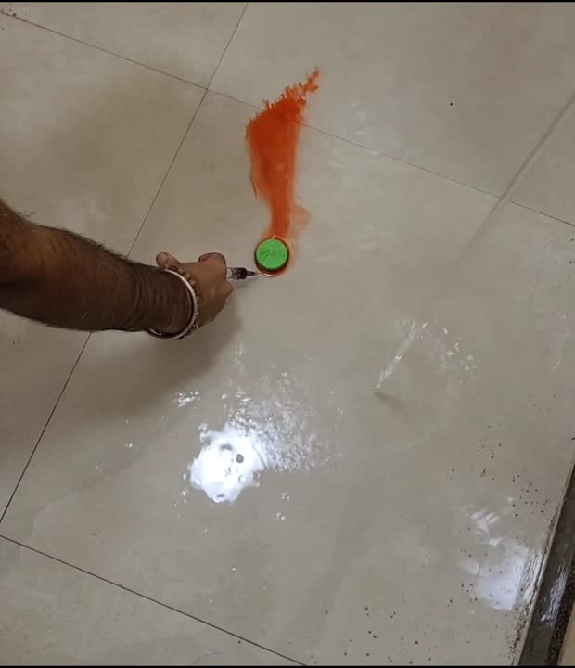
The Experiment

Slide 38
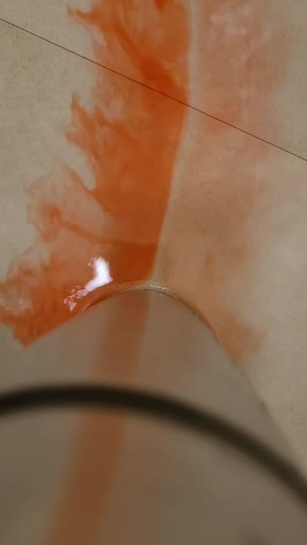
The Experiment

Slide 39
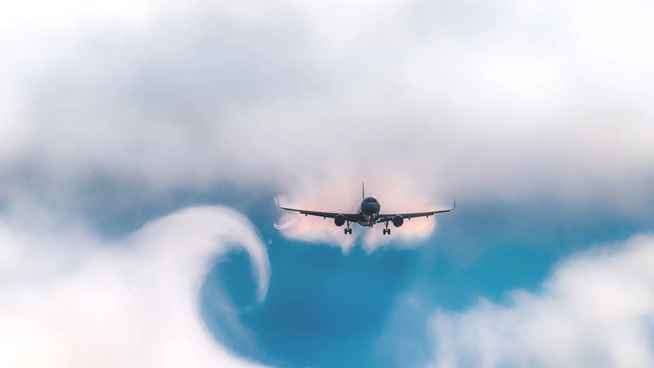
WHY TURBULENCE IS
CONTROVERSIAL

Slide 40
Every aspect of turbulence is controversial
Even the definition of fluid turbulence is a subject of disagreement
However, nearly everyone after this presentation (hopefully!) would agree with some elements of the description next slide

Slide 41
Turbulence requires the presence of vorticity; irrotational flow is smooth and steady to the extent that the boundary conditions permit
Turbulent flow has a complex structure, involving a broad range of space and time scales
Turbulent flow fields exhibit a high degree of apparent randomness and disorder. However, close inspection often reveals the presence of embedded coherent flow structures
Turbulent flows have a high rate of viscous energy dissipation
Advected tracers are rapidly mixed by turbulent flows

Slide 42
However, one further property of turbulence seems to be more fundamental than all of these because it largely explains why turbulence demands a statistical treatment...
Turbulence is chaotic!!

Slide 43
Questions?

Slide 44
References
http://www.astro.yale.edu/vdbosch/astro320_summary12.pdf
https://ocw.mit.edu/courses/12-820-turbulence-in-the-ocean-and-atmosphere-spring-2007/f1e8a69cb4d94121f4b23e9f5dcb84bb_ch2.pdf
https://github.com/Ceyron
https://en.wikipedia.org/wiki/K%C3%A1rm%C3%A1n_vortex_street

Slide 45
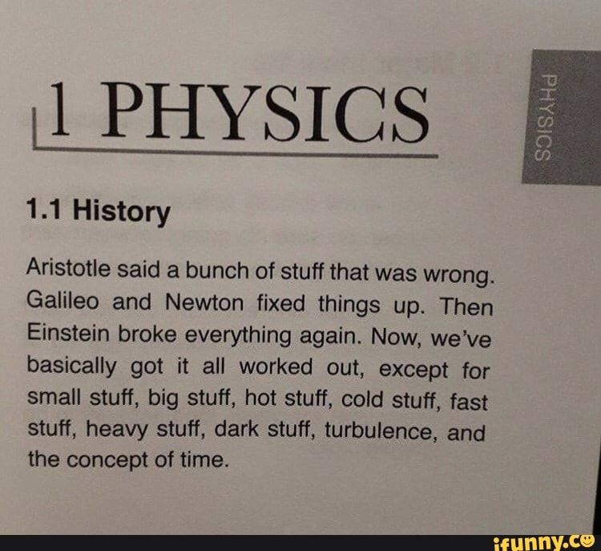

Slide 46
thank
you

Slide 47
If there is some time left...

Slide 48
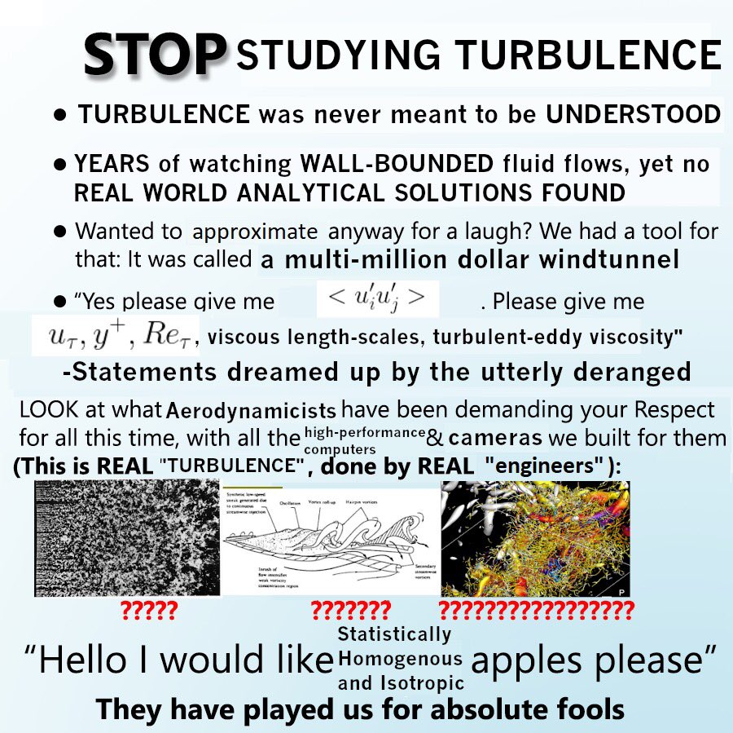

Slide 49
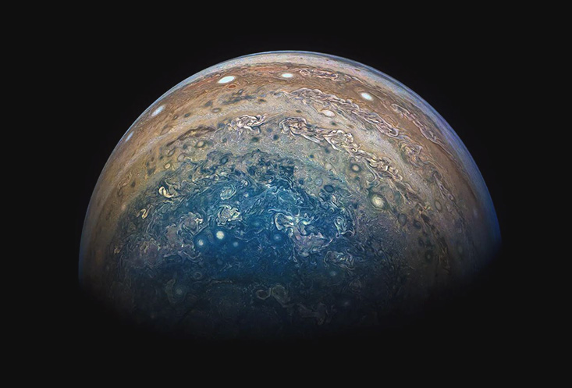
STATISTICAL TREATMENT OF
TURBULENCE

Slide 50
Considering the universality of turbulence, a natural question arises: how can we understand this chaotic phenomenon?

Slide 51
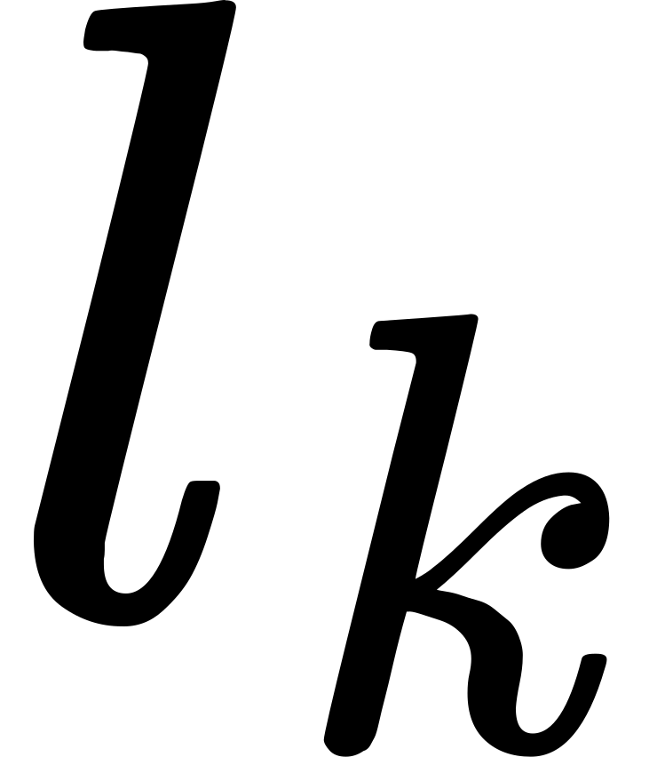
To date, turbulence energetics is best understood by energy cascade from large scales where energy is fed into the system down to small scales where dissipation takes central stage.
The smallest scale reached by energy cascade is known as Kolmogorov length, and marks the point where dissipation takes over advection and organised fluid motion dissolves into incoherent molecular motion.

